Slide 1
User Interface Manager
Practical example of dependency injection
Piotr Kruczkowski
Software/Solutions Engineer CLA CTA
ni.com

Slide 2
Agenda
Problem Statement
How Others Do It?
How We Do It?
The Solution – User Interface Manager
API
UI Manager Tool
QuickDrop
Right Click Menu
XML
Custom Plugin UIP
Universal Code
Summary

Slide 3
Problem Statement
Big applications
Hundreds of controls and indicators
Hundreds of UI states possible
Thousands of properties to be manipulated

Slide 4
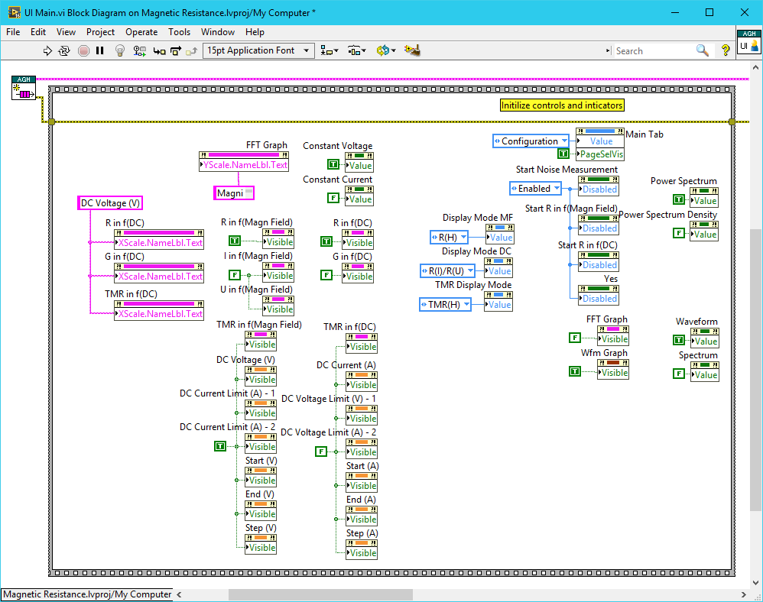
How We Do It?
Manual calls to property nodes
Big, clunky, don’t fit on the screen
Code duplication leads to bugs
Frustrating
Race conditions
Wiring
Frequently the same
Cannot be automated
Not parsable
UI modifications recompilation
Not SCC friendly
▪ …

Slide 5
How Others Do It?
XAML, GladeXML, Qt Designer, FXML
UI/Application Markup Languages
Easy to edit
Structured
Parsable
Scriptable
Detach UI from code
NOT available in LabVIEW

Slide 6
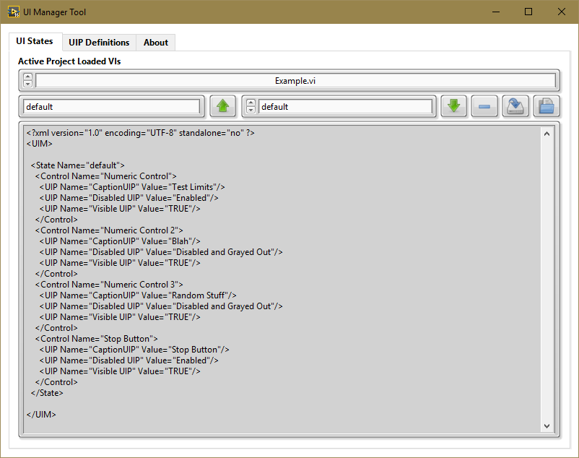
UI Manager
XML based
Programmatic API
UI Manager Tool for LV
Any VI Server controls
Any properties
Plugin based
Extensible

Slide 7
Remove State
Capture
Select State
Apply State
Select VI
Name State XML View
Load XML
Save XML

Slide 8
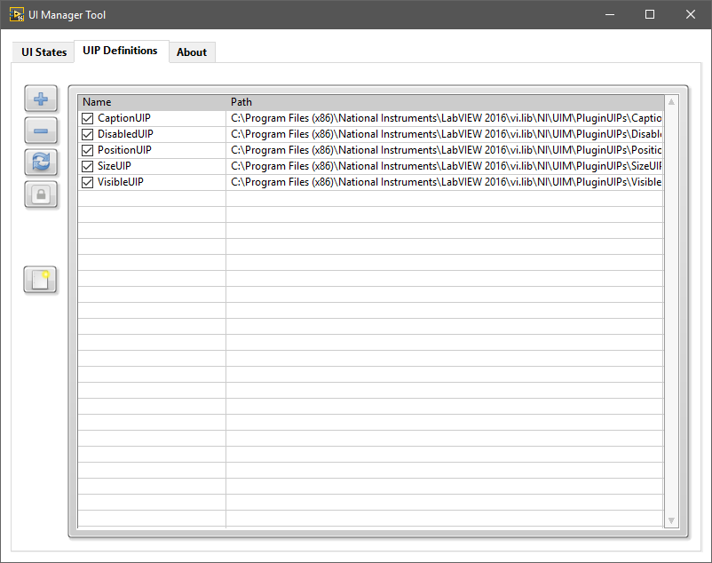
Enable UIP Capture
Loaded UIPs
Add UIP
Remove UIP
Reload UIPs Toggle Enable New UIP

Slide 9
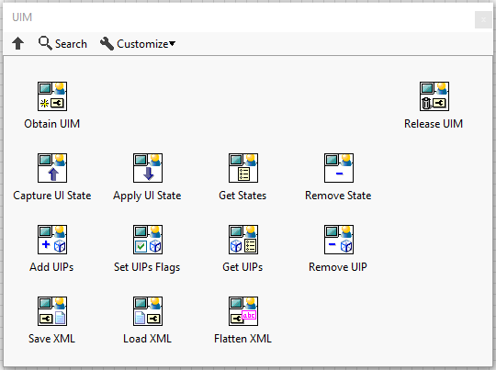
Capture UI State
API
Apply UI State
Manipulate Plugin UIP
Export/Import XML

Slide 10
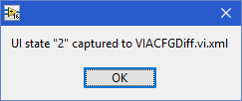
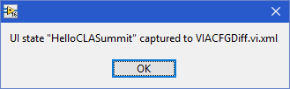
QuickDrop Shortcut
Quicker way to create and capture state
<Ctrl>+<U> - incrementing name
<Ctrl><Shift>+<U> - custom name
UIP from plugin folder only
XML name same as the VI

Slide 11
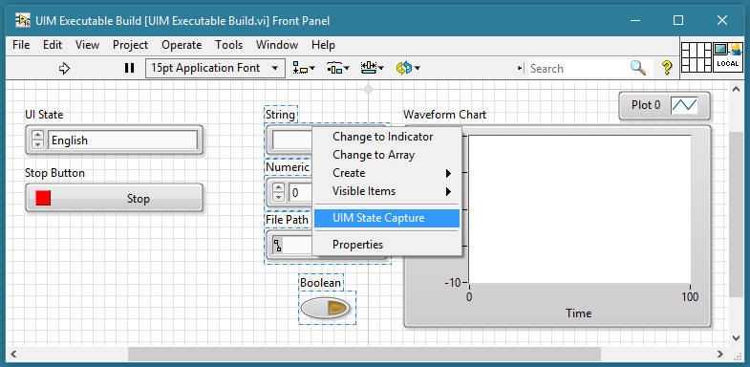
Right Click Menu
Quickest way to create and capture state
Select one or many controls
Capture state using right click menu shortcut
Operates the same way as QuickDrop Shortcut

Slide 12
XML
<?xml version="1.0" encoding="UTF-8" standalone="no" ?>
<UIM>
<State Name="default">
<Control Name="Abort Cal">
<UIP Name="CaptionUIP" Value="Abort Cal"/>
<UIP Name="DisabledUIP" Value="Disabled and Grayed Out"/>
<UIP Name="PositionUIP" Value="2, 81"/>
<UIP Name="VisibleUIP" Value="TRUE"/>
</Control>
<Control Name="Begin Cal">
<UIP Name="CaptionUIP" Value="Begin Cal"/>
<UIP Name="DisabledUIP" Value="Disabled and Grayed Out"/>
<UIP Name="PositionUIP" Value="2, 54"/>
<UIP Name="VisibleUIP" Value="TRUE"/>
</Control>
</State>
</UIM>
Structured
Easy to edit
Parsable
Scriptable
Detached from code

Slide 13
Dependency Injection
In software engineering, dependency injection is a technique whereby one object supplies the dependencies of another object. A dependency is an object that can be used (a service). An injection is the passing of a dependency to a dependent object (a client) that would use it.
Plugin LabVIEW class and its methods – dependency
Loading from folder and using in a generic framework – injection
Plugin frameworks, interfaces

Slide 14
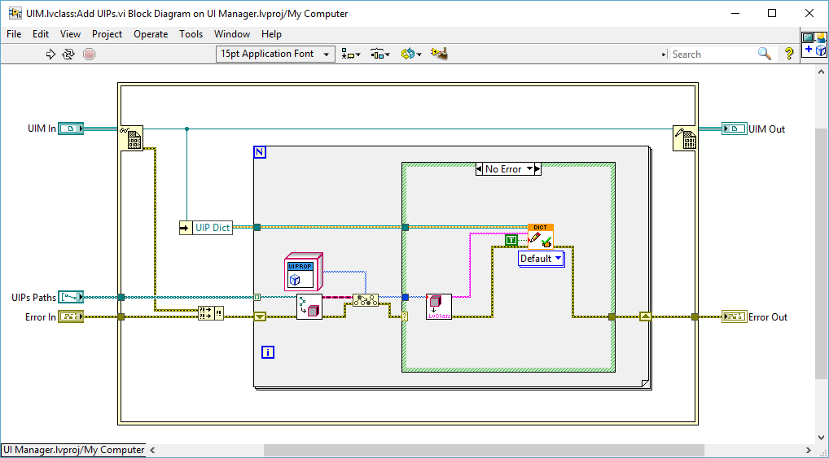
Dependency Injection

Slide 15
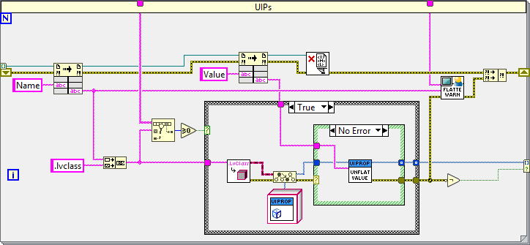
Loading UI Property Plugins From XML

Slide 16
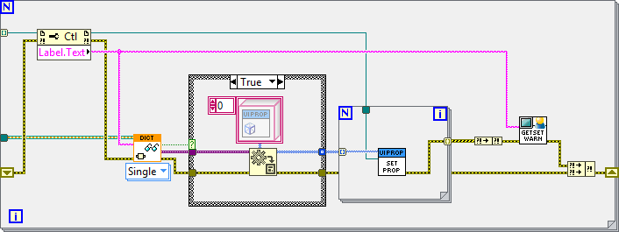
Applying UIP to Control by Label

Slide 17
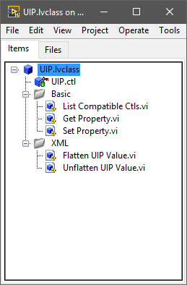
Custom Plugin UIP
Inherits from UIP
Provide override for 5 methods
Get State
Set State
List Compatible Ctls
Flatten UIP Value
Unflatten UIP Value
Can be placed within default UPIs folder
Can be loaded dynamically
Template available in the UI Manager Tool

Slide 18
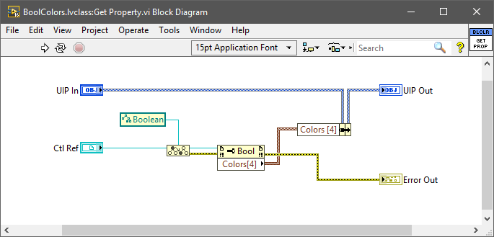
BoolColorsUIP – Get Property.vi

Slide 19
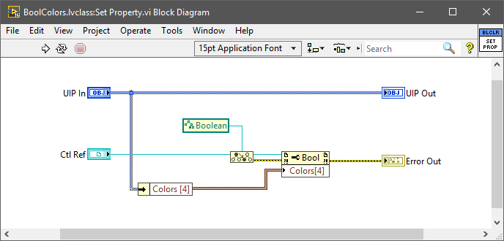
BoolColorsUIP – Set Property.vi

Slide 20
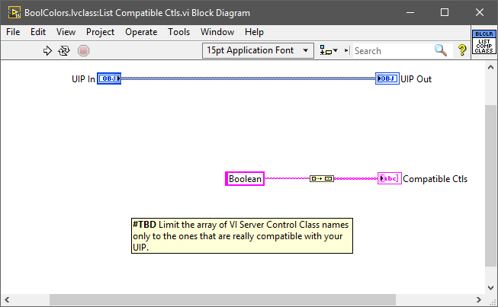
BoolColorsUIP – List Compatible Ctls.vi

Slide 21
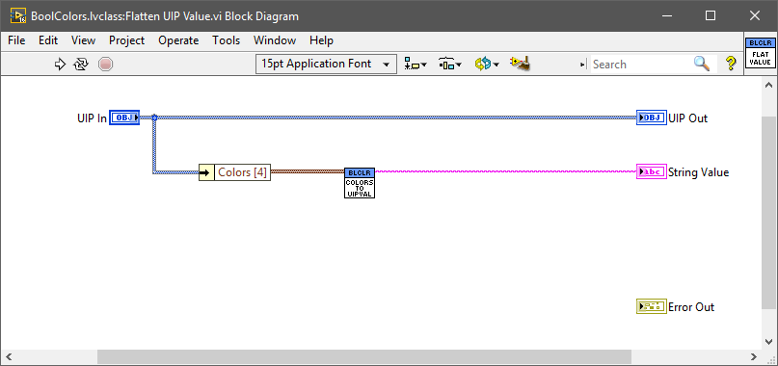
BoolColorsUIP – Flatten UIP Value.vi

Slide 22
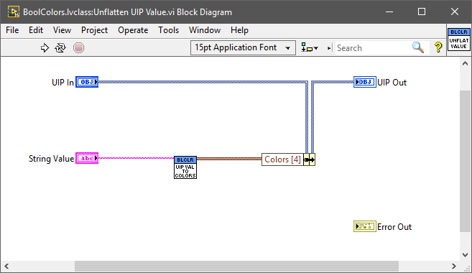
BoolColorsUIP – Unflatten UIP Value.vi

Slide 23
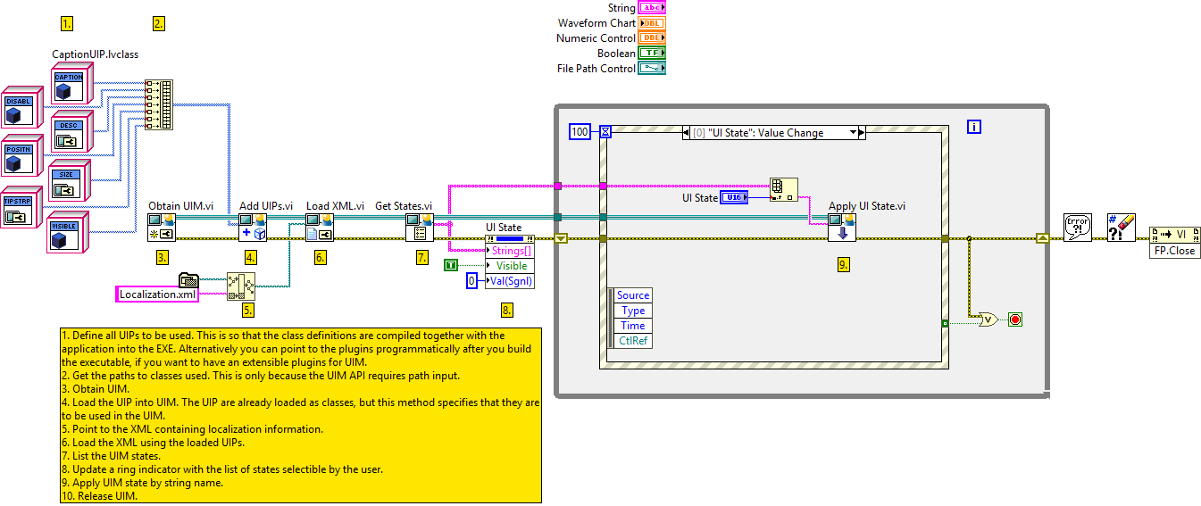
Universal Code Example

Slide 24
Summary
Can be used by anyone – default UI state, resolutions
For bigger application indispensable
Detach UI editing from source code – no recompilation!
Allow for easier team based development
One standard
No excuses
http://forums.ni.com/t5/UI-Interest-Group-Documents/User-Interface-Manager/ta-p/3539490

